Slide 1
15. JAVA OOPs CONCEPTS
Presented By S.R.Zameer

Slide 2
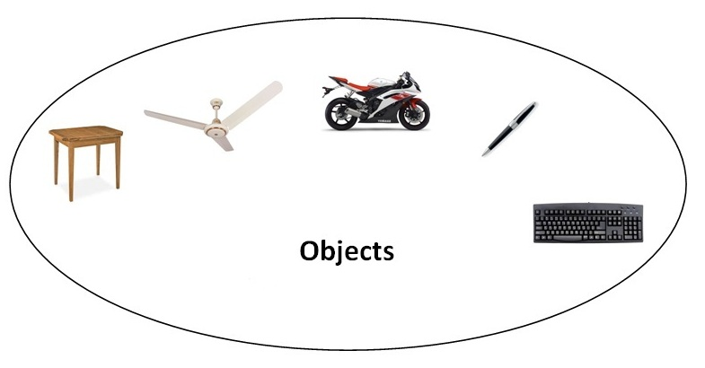
OOPs (Object Oriented Programming System)
Object means a real word entity such as pen, chair, table etc. Object-Oriented Programming is a methodology or paradigm to design a program using classes and objects.

Slide 3
OOPs (Object Oriented Programming System)
Object means a real word entity such as pen, chair, table etc. Object-Oriented Programming is a methodology or paradigm to design a program using classes and objects.

Slide 4
Contd…
It simplifies the software development and maintenance by providing some concepts:
Object
Class
Inheritance
Polymorphism
Abstraction
Encapsulation

Slide 5
Object
Any entity that has state and behavior is known as an object. For example: chair, pen, table, keyboard, bike etc. It can be physical and logical.

Slide 6
Class
Collection of objects is called class. It is a logical entity.

Slide 7
Inheritance
Inheritance is a mechanism wherein a new class is derived from an existing class. In Java, classes may inherit or acquire the properties and methods of other classes.
A class derived from another class is called a subclass, whereas the class from which a subclass is derived is called a superclass. A subclass can have only one superclass, whereas a superclass may have one or more subclasses.

Slide 8
Polymorphism
Polymorphism is the ability of an object to take on many forms. The most common use of polymorphism in OOP occurs when a parent class reference is used to refer to a child class object.

Slide 9
Abstraction
Hiding internal details and showing functionality is known as abstraction. For example: phone call, we don't know the internal processing.

Slide 10
Encapsulation
Binding (or wrapping) code and data together into a single unit is known as encapsulation. For example: capsule, it is wrapped with different medicines.
A java class is the example of encapsulation. Java bean is the fully encapsulated class because all the data members are private here.

